Slide 1

LODGEFY
Your Smart Guide To The Perfect Hostel Stay

Slide 2
Problem Statement
Problem statement : For students relocating to new cities for education, finding suitable, affordable accommodations such as hostels and PGs can be a complex and often frustrating experience.
The current process typically involves time-intensive research, in-person visits, and
navigating fragmented, unverified sources, leading to inefficiency and stress.
There is a clear need for a streamlined, trustworthy solution to simplify the accommodation search process.

Slide 3
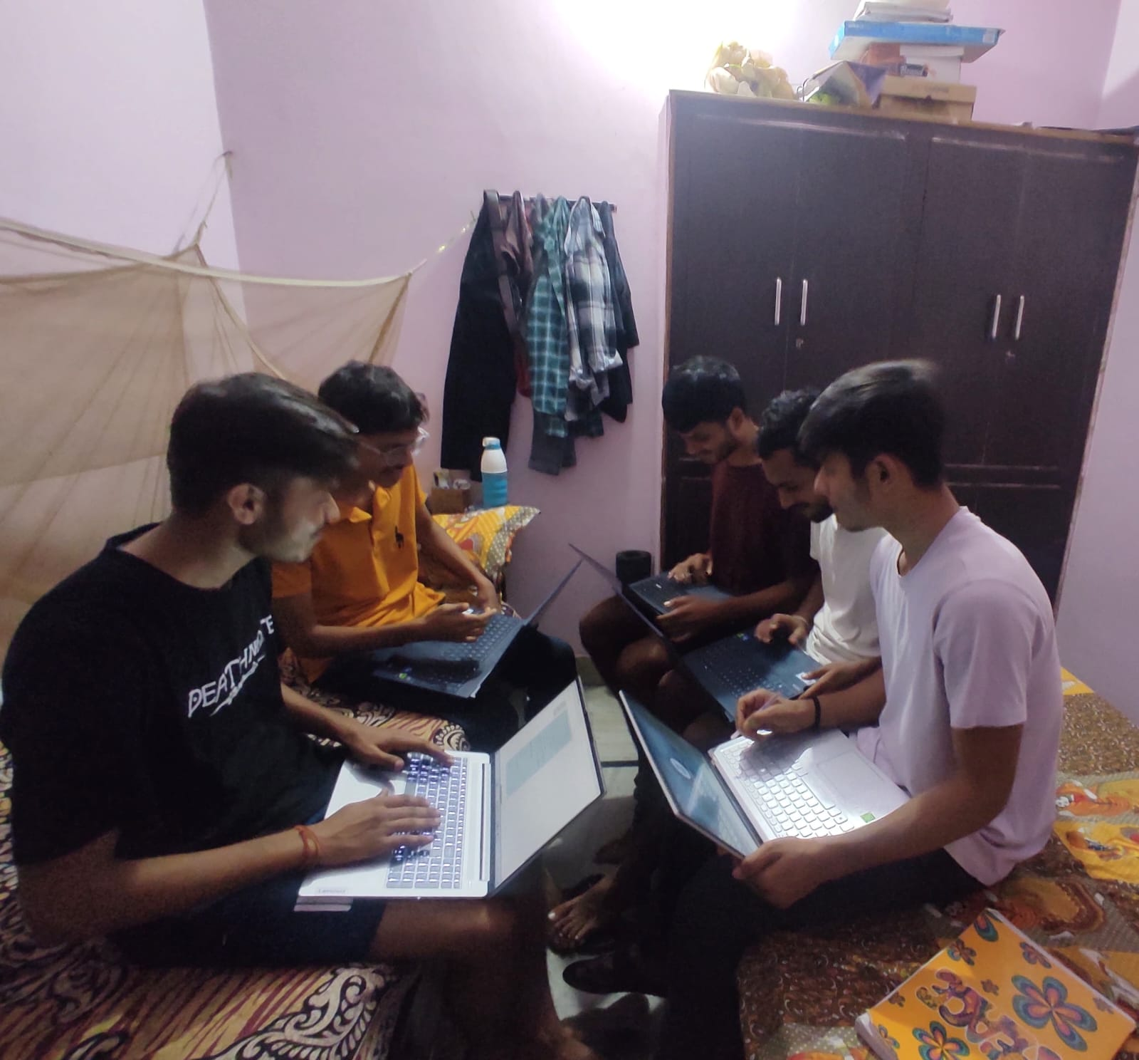
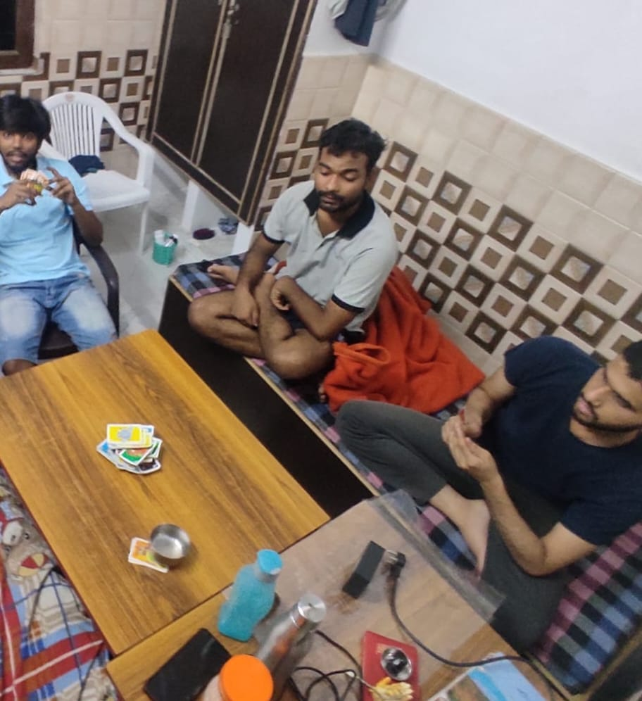
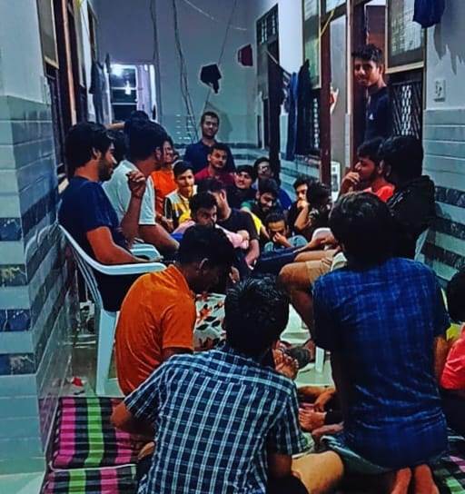
On Ground Analysis
Sharma PG and Hostel
Divyanshi Hostel
White House PG
PG owner charges more rent from the new comer who are new to the city.
Most of the PG’s near the colleges are much expensive and the cheaper one are unknown to us.
As a new comer we are unknown about the Food quality and realises it after admitting into the PG.
Fake promises / information about facilities in PG.
As a newcomer we don't know about many things in that particular area and when we required to change the PG we have only limited options as we are actually unknown.

Slide 4

OUR MAIN COMPETITORS
NO BROKER
COLIVE
ZOLO STAYS
No Broker focuses on real
estate, helping users find
homes, apartments, and commercial properties.
Zolo Stays offers managed co-living spaces for students and professionals, focusing on fully-serviced accommodations with added amenities but focuses on major cities.
Colive focuses on providing fully-managed, long-term co-living spaces for professionals, offering amenities like housekeeping and shared living experiences.
NESTAWAY
Nestaway primarily focuses on helping users find rental homes and apartments, offering managed living spaces for families, bachelors, and professionals.

Slide 5
ABOUT LODGEFY
Lodgefy: The Ultimate Hostel Recommendation Platform it is designed to simplify the search for hostels by providing students with a seamless platform to discover and book hostels with real-time updates and personalized features.
Our Target Audience : Students: Primarily college and university students seeking affordable and convenient living arrangements near their campuses.
LODGEFY
LODGE
FY
It refers to temporary accommodation such as hostels, PG's, rental rooms etc.
It is an suffix which means "to turn into" and here it implies making the process easier.

Slide 6
UNIQUENESS OF PROJECT
Community Features for Students
Focus on Security
Advanced Hostel Search Filters
Real-Time Availability
Hostel Management Features
Comprehensive Details
It forsters social features that connect hostels.
Listing of only verified PG’s on our platform
It help user to find hostel based on location,budget,etc
Helps the user to know whenever the room is available
It makes easy with tools for booking payment .
Provides every authentic details around colleges.

Slide 7
TECH STACK
Used to structure the content and elements as per our need.
Used to style the html components in order to make it more attractive..
Used to carry out all the work flow and to provide interactivity to our website.
HTML
CSS
JAVASCRIPT
Iframe, Div tag
Anchor tag, p tag
h tag, i tag
etc
Flex Box
Transform, Transition
Box Shadow etc
Event Listeners , QuerySelectors, Objects, Function
Etc.

Slide 8
Work Flow :
Abhay Saharawat
Deepanshu Rana
Page Layout
(Html)
Addition of Responsiveness
Using JavaScript
Enhancing Html Layout
Ayush Raj
CSS Styling
Html page on demand
Enhancing CSS Styling
Ashirwad Pal

Slide 9
OUR PROCESS
ANALYSIS
TESTING
Conducting market research,gathering requirements.
Testing and Deployment Phase to ensure web application is working as expected and free of major bugs.
DEVELOPMENT
MARKETING
Actual coding and development of the frontend and backend systems and their integration. Followed by collecting all the sample data of PG's for example location, photo etc.
Marketing and Outreach Phase involves promoting our platform and establishing partnerships with PG owners.

Slide 10

BUSINESS MODEL
Engage Hostel Owners and PG Managers : Offer hostel and PG owners value-added services.
Google Ads and Facebook Ads : Run paid ad campaigns targeting students, working professionals, and travellers who frequently search for accommodation.
Expand to New College Campus : Once we have a solid user base in your initial location, we will expand to new locations where there is demand for PG/hostel accommodations.
Student Influencers : Collaborate with local student influencers or campus bloggers who have a large following among their peers. Have them create content about finding accommodations, reviewing hostels, and promoting Lodgefy.

Slide 11
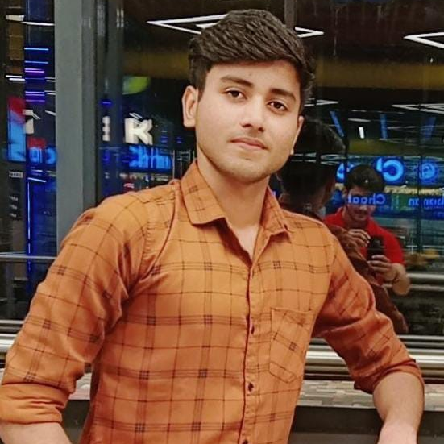
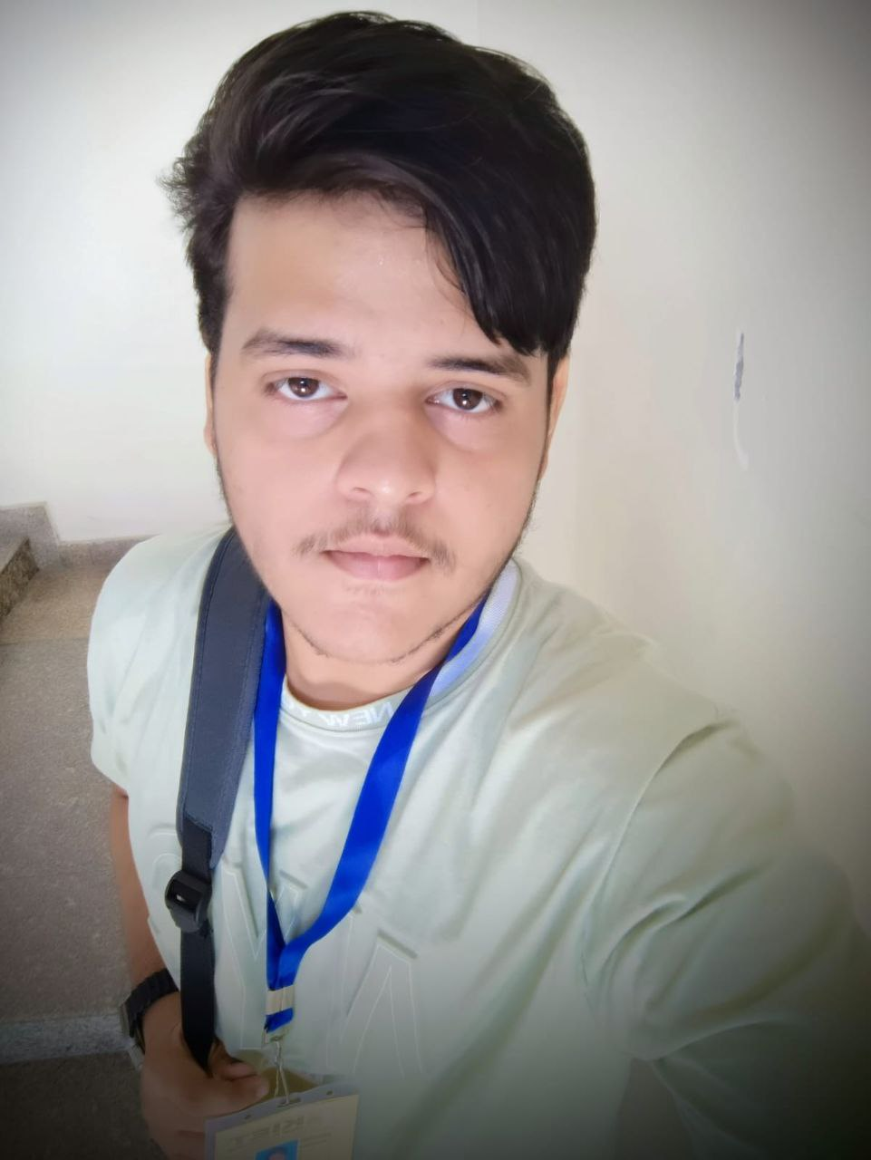
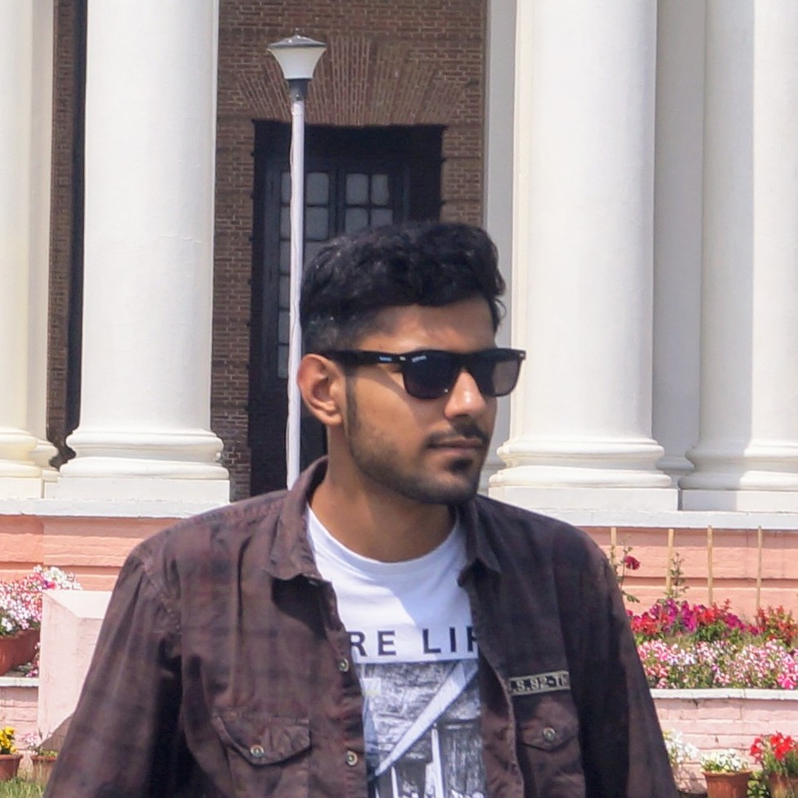
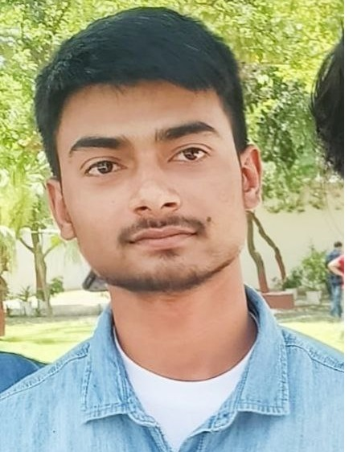
OUR TEAM
Ayush Raj
Deepanshu Rana
Abhay saharawat
Ashirwad Pal
Mainly Worked on JS
Html and CSS Enhancer
Worked as a Integrater
Tech Stack used Html and CSS
Worked collaborating on Html pages.
Worked as a page designer
Tech Stack used Html and CSS

Slide 12
Thanks You

